Slide 1


Lesson 17 Receiving mail
UNIT 4

Slide 2
Guess the word
message
address
attachment
appliance
ELECTRONIC
delete
write
check
forward
read
send

Slide 3
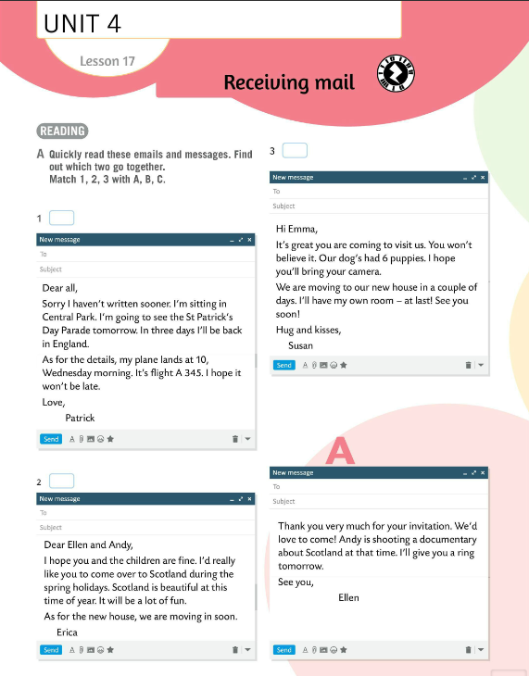
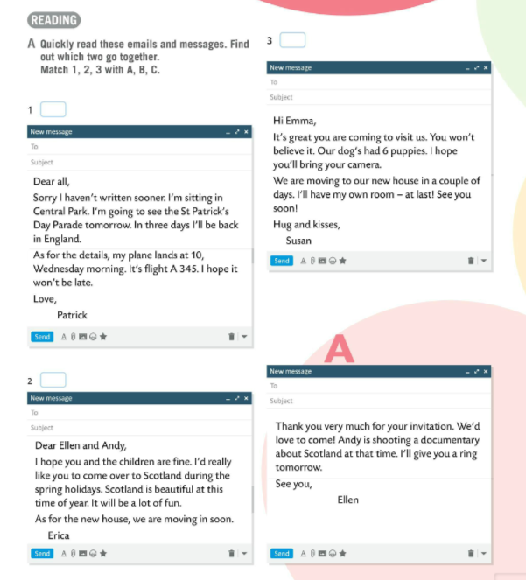
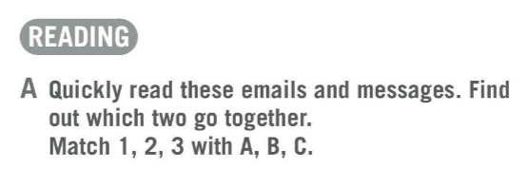
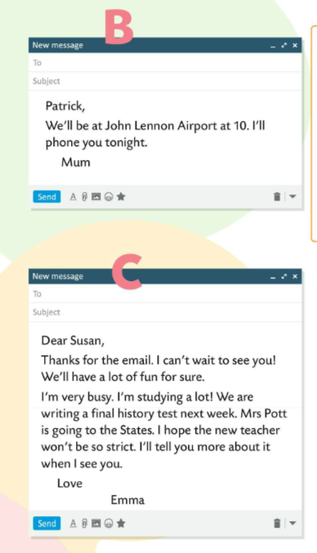
Quickly read emails and messages in Task A.
Find out which two go together.
Match 1, 2 ,3 with A, B, C.
C
B
Check.
A

Slide 4
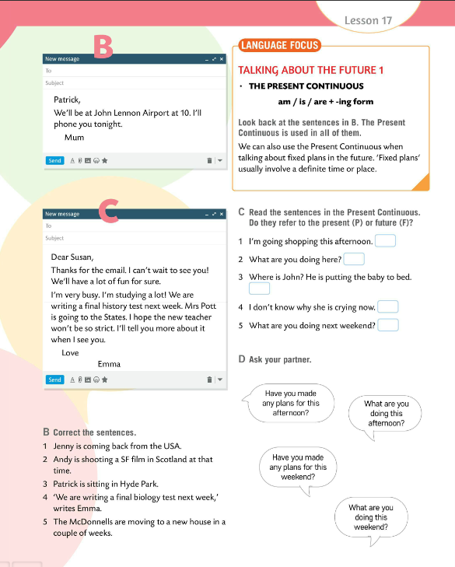
Translate:
(a plane) (zrakoplov)
lands / takes off – slijeće / polijeće
airport – zračna luka
flight – let
move in / to – useliti / preseliti
advice – savjet
decorate – ukrasiti
accept an invitataion – prihvatiti poziv

Slide 5
Read emails and messages from Task A again and find the following expressions:
1. Jedva čekam da te vidim!
2. Vidimo se uskoro.
3. Nazvat ću te.
4. A što se tiče detalja…
Check.
1 I can't wait to see you!
2 See you soon.
3 I'll give you a ring. / I'll phone you.
4 As for the details…

Slide 6
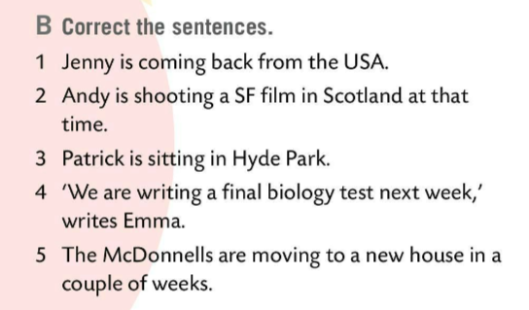
Correct the sentences in Task B. Write in your notebook.
Check.
1 Patrick is coming back from the USA.
2 Andy is shooting a documentary in Scotland.
3 Patrick is sitting in Central Park.
4 We are writing a final histroy test next week.
5 The McDonnells are moving to a new house in a couple of days.

Slide 7
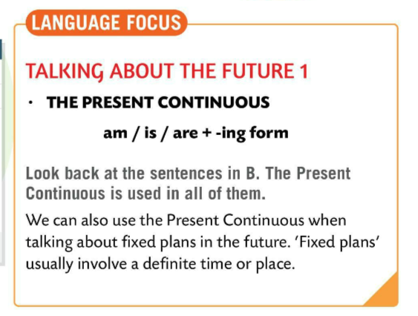
LANGUAGE FOCUS
We use the Present Continuous to talk about an action happening now.
AM/IS/ARE + -ING
I’m watching TV now.
We can also use the Present Continuous when talking about fixed plans in the future. ‘Fixed plans’ usually involve a definite time or place.
Present continuous je glagolsko vrijeme koje koristimo za izražavanje buduće radnje koju smo već isplanirali. Ta buduća radnja u Present Continuousu obično ima jasno određeno vrijeme i mjesto odvijanja u budućnosti.
I’m visiting my grandparents next week.

Slide 8
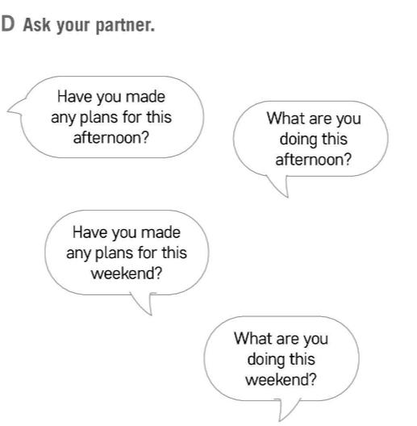
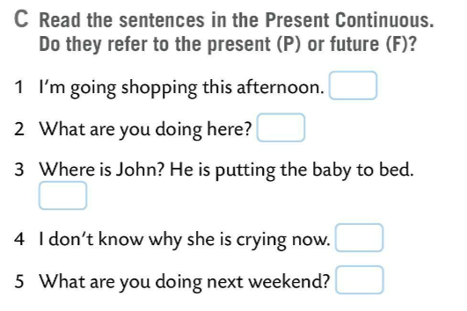
Underline the verbs in the present continuous in Task B.
F
Check.
P
Read the sentences in Task C. Do they refer to the present (P) or future (F)?
P
P
F
Check.
Ask your partner questions from Task D.

Slide 9
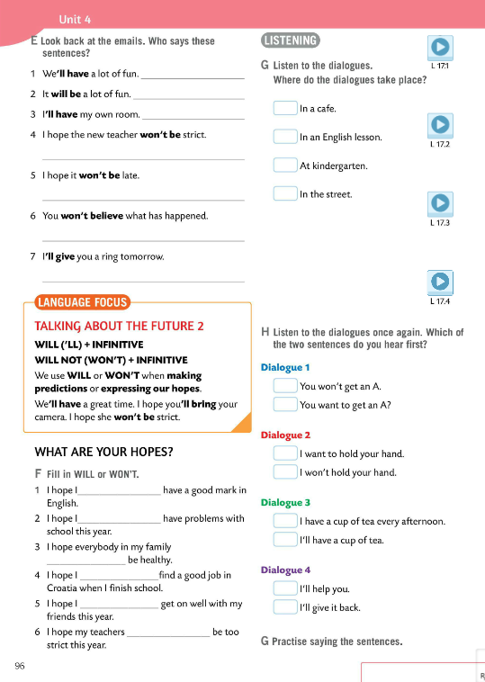
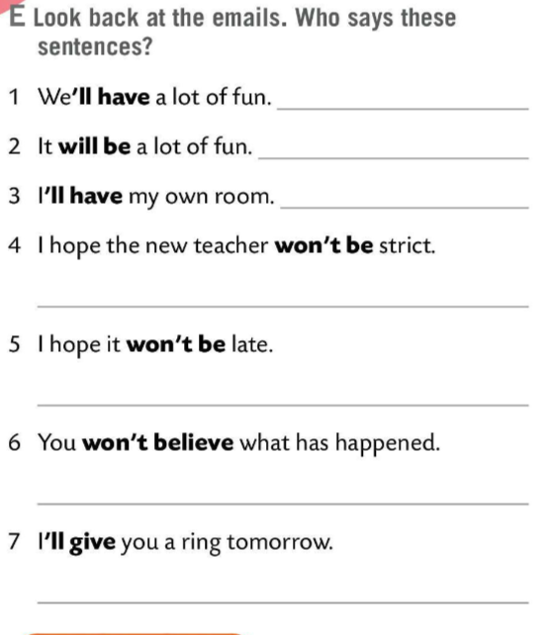
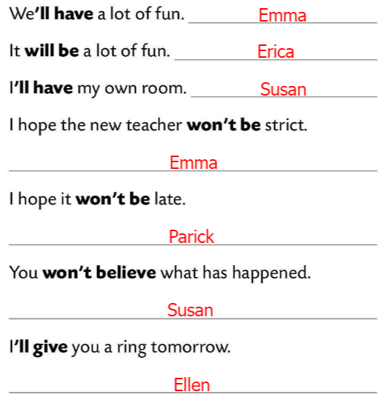
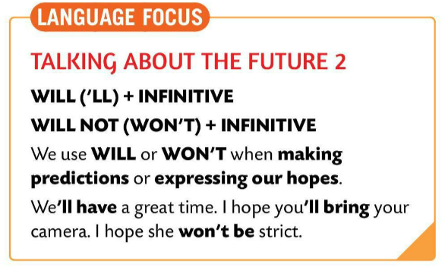
Look back at the emails. Who says the sentences in Task E?
Check.
LANGUAGE FOCUS
We use WILL (‘LL) or WON’T (WILL NOT) when making predictions or expressing our hopes.
SUBJECT + WILL + INFINTIVE (without TO)
We’ll have a great time.
I hope the techer won’t be strict.
Za izražavanje naših predviđanja za budućnost te nadanja koristimo WILL (‘LL) i WON’T (WILL NOT).

Slide 10
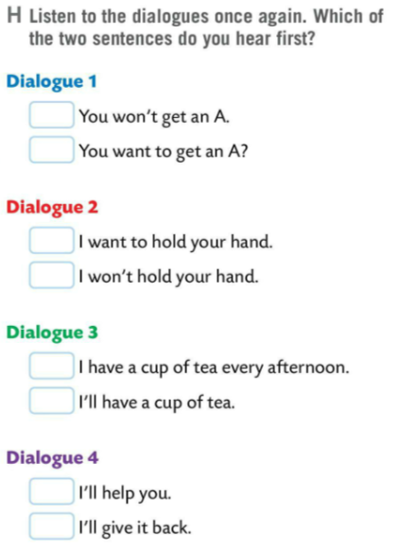
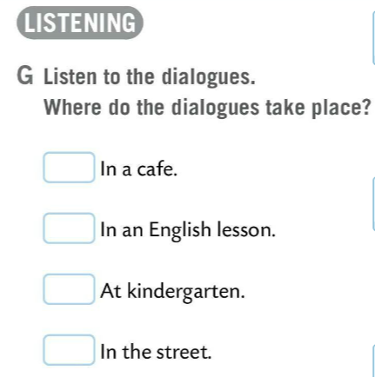
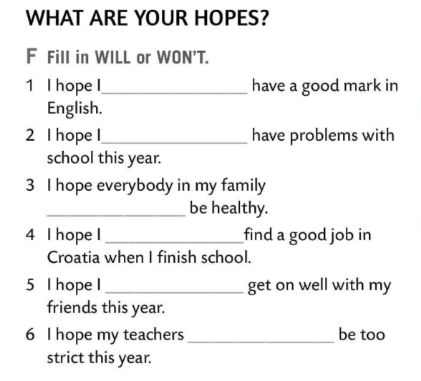
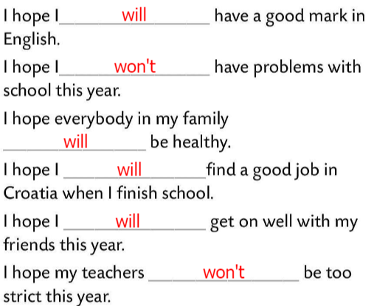

Fill in the gaps in Task F.
Use WILL or WON’T.
Check.
2
Listen to the dialogues. Solve Task D.
Where do the dialogues take place?
1
3
1
2
1
Check.
Do Task H. Listen to the dialogues once again. Decide which of the two sentences you hear first?
2
2
1
4
1
2
Check. Practise saying the sentences.

Slide 11
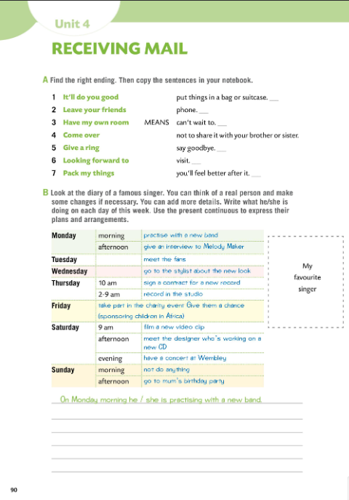
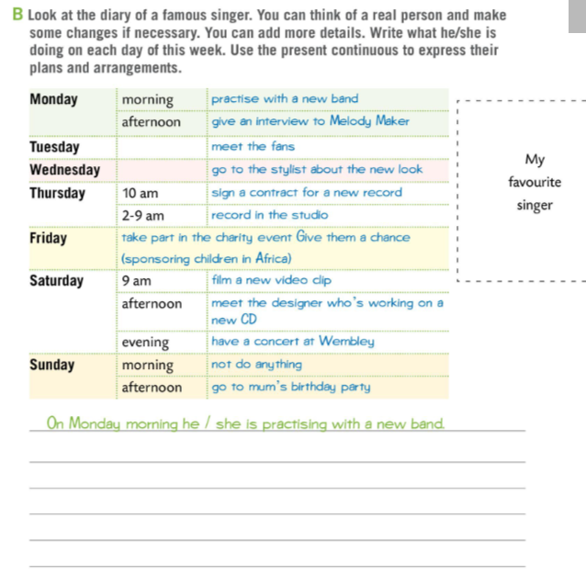

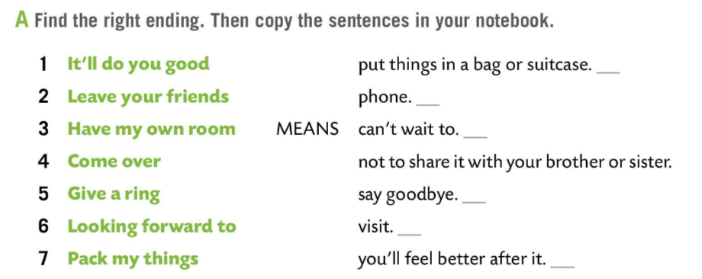
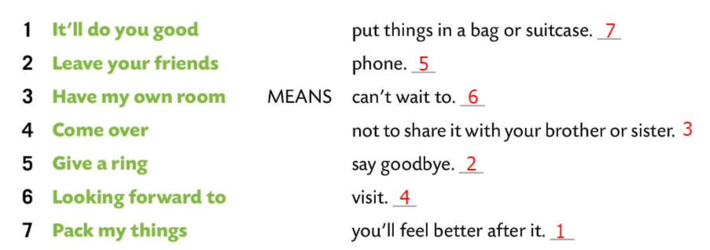
Workbook page 90.
Find the right ending in Task A. Copy the sentences.
Check.
Look at the diary of a famous singer. You can think of a real person and make some changes if necessary. You can add more details.
Write what he/she is doing on each day of this week. Use the present continuous to express their plans and arrangements.
Check in class.

Slide 12
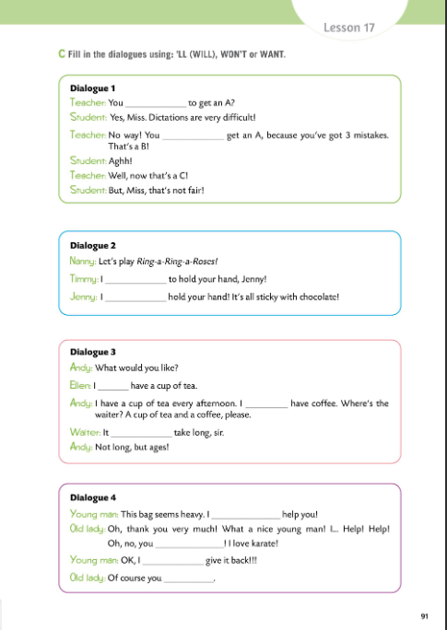
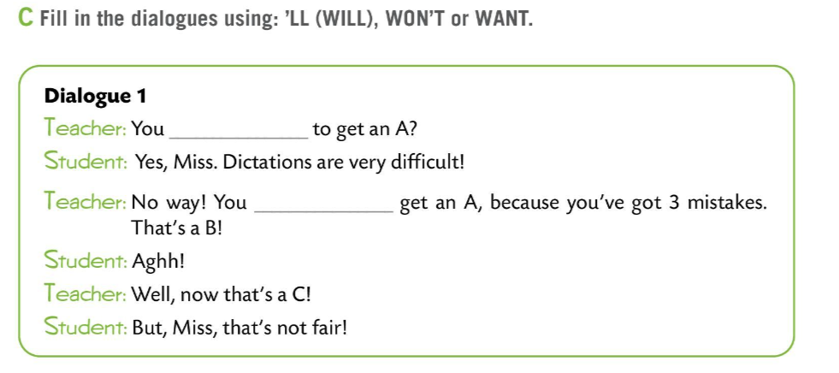
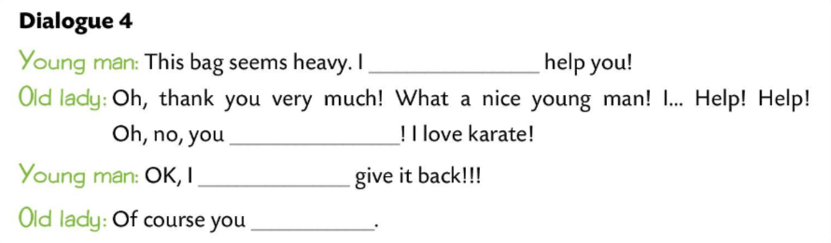
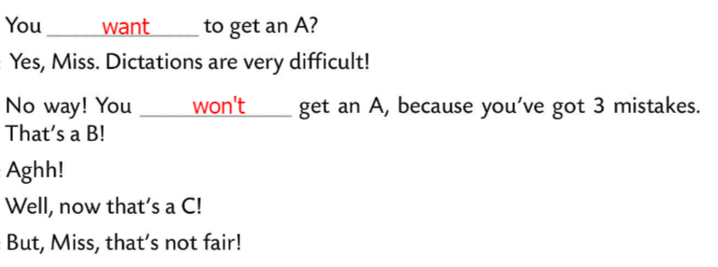
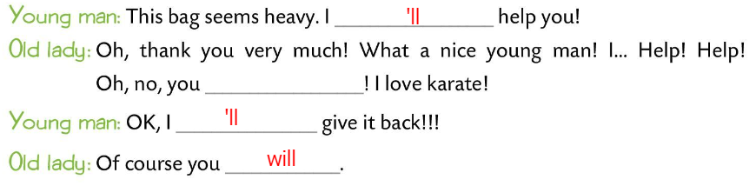
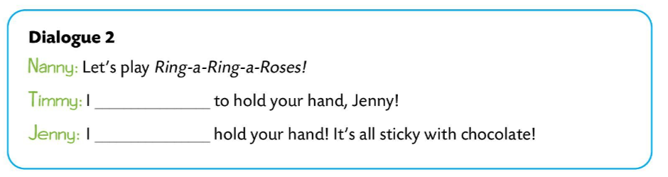
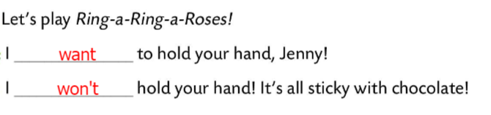
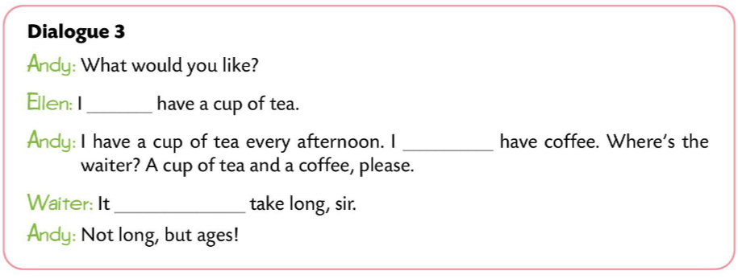
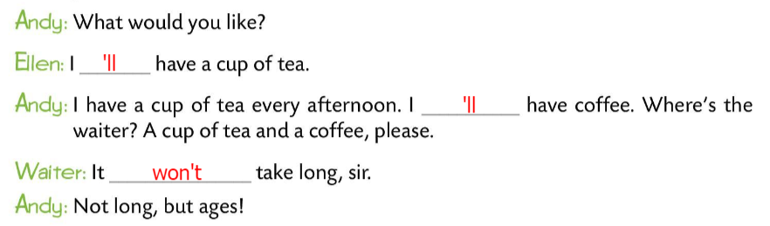
Workbook page 91.
Fill in the dialogues in Task C.
Use ‘LL (WILL), WON’T or WANT.
Check.

Slide 13
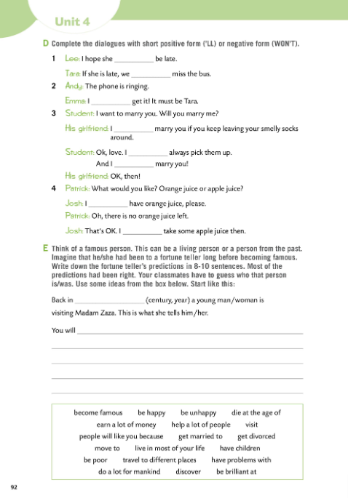
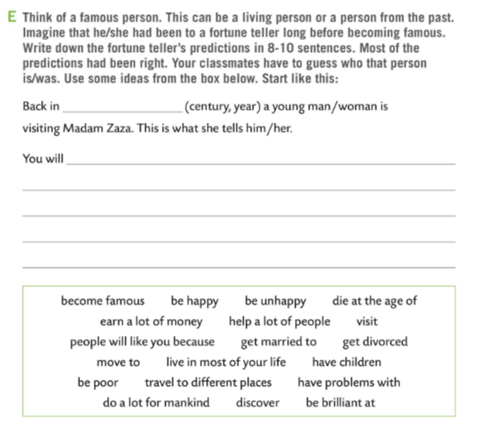
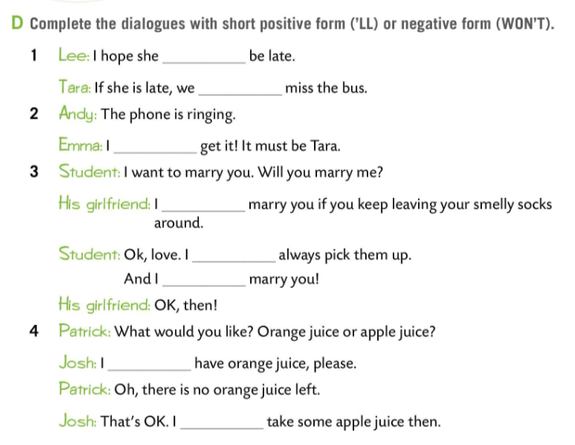
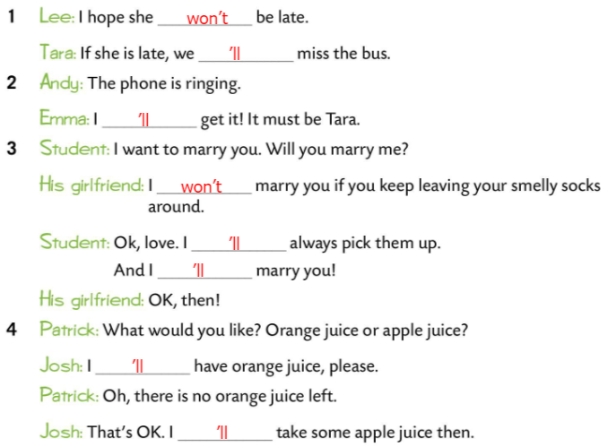
Workbook page 92.
Complete the dialogues with short positive form (‘LL) or negative form (WON’T.)
Check.
Do Task E.
Think of a famous person. This can be a living person or a person from the past. Imagine that he/she had been to a fortune teller long before becoming famous.
Write down the fortune teller’s predictions in 8-10 sentences. Most of the predictions had been right.
Your classmates have to guess who that person is/was. Use some ideas from the box below.

Slide 14
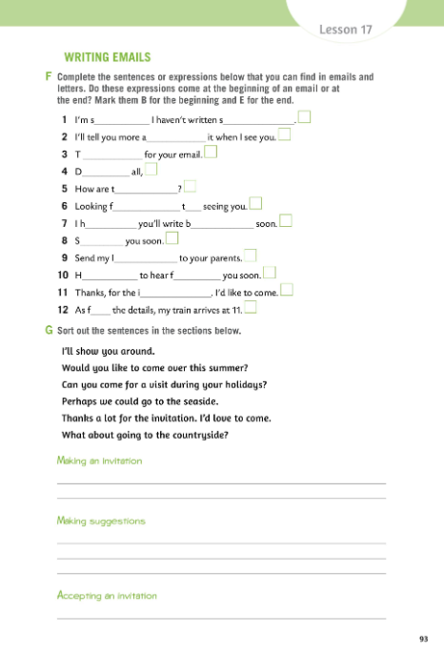
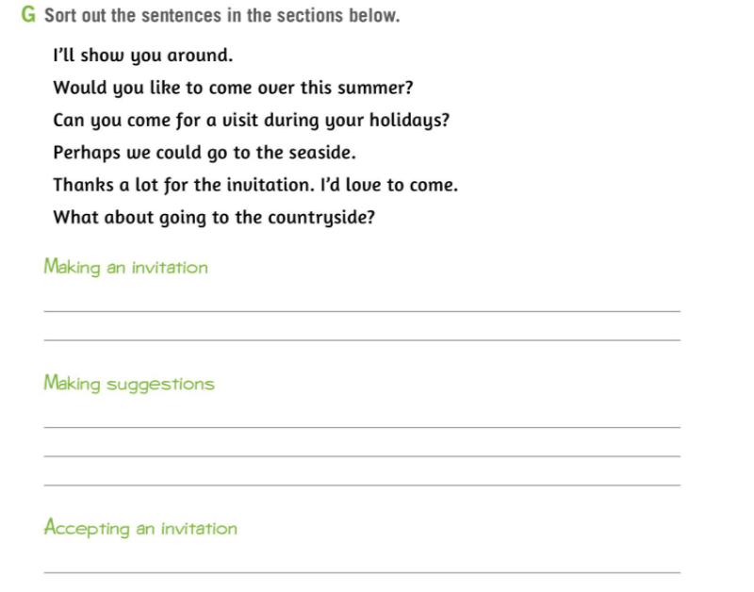
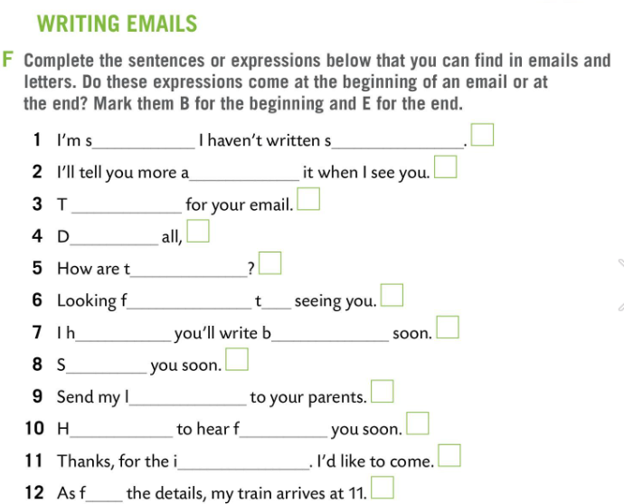
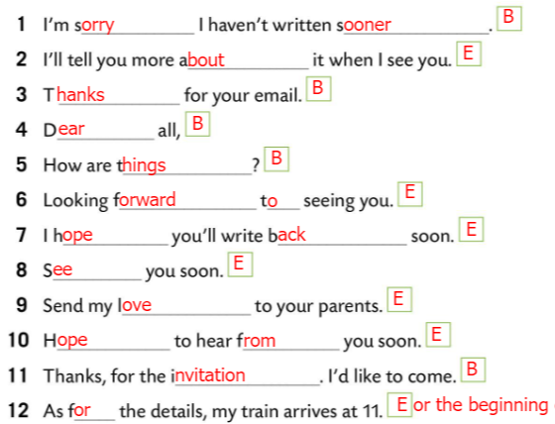
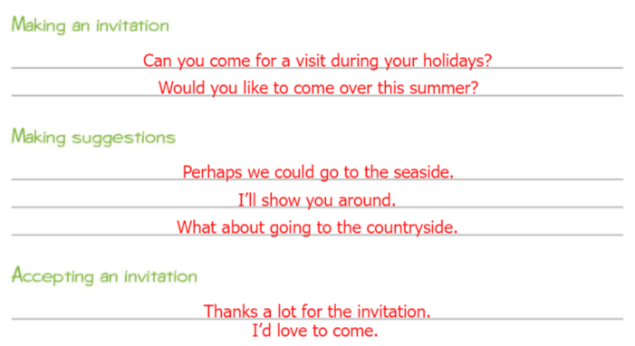
Workbook page 93.
Complete the sentences or expressions below that you can find in emails and letters.
Do these expressions come at the beginning of an email or at the end? Mark them B for the beginning or E for the end.
Check.
Sort out the sentences from Task G into the sections.
Check.

